Slide 1
Graphics with SVG

Slide 2
Contents
Getting started with SVG
Drawing curves
Setting styles
Additional techniques
Demos folder:
Demos\D-Svg

Slide 3
1. Getting Started with SVG
Recap of SVG concepts
A simple SVG example
Drawing straight lines

Slide 4
Recap of SVG Concepts
SVG enables you to draw 2D vector graphics
Using XML elements
Retained mode
The objects tree is kept in memory
SVG XML elements
Elements for a wide range of graphics elements
You can style elements with CSS
Full DOM support
You can access SVG elements through DOM

Slide 5
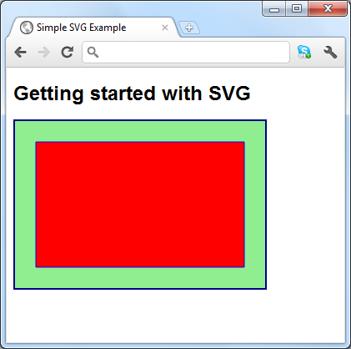
A Simple SVG Example
Here's a simple SVG example
<style>
svg {
border: 2px solid darkblue;
background-color: lightgreen;
width: 300px;
height: 200px;
}
</style>
…
<h1>Getting started with SVG</h1>
<svg xmlns="http://www.w3.org/2000/svg">
<title>Simple SVG Example</title>
<desc>An SVG with a rectangle</desc>
<rect x="25" y="25" width="250" height="150" fill="red" stroke="blue" />
</svg>
GettingStartedWithSVG.html

Slide 6
Drawing Straight Lines (1 of 2)
To draw a rectangle:
To draw a polygon or polyline:
To draw a path:
For full details about <path>, see: http://www.w3.org/TR/SVG/paths.html
<rect x="50" y="50" width="100" height="75" rx="20" ry="20"
fill="yellow" stroke="blue" />
<polygon points="110 70, 150 40, 190 70, 190 160, 150 130, 110 160"
fill="yellow" stroke="blue" />
<polyline points="105 100, 120 100, 125 90, 135 110, 145 90, …
fill="none" stroke="blue" />
<path d="M 150 50 L 250 150 L 50 150 Z"
fill="red" stroke="blue" />

Slide 7
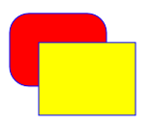
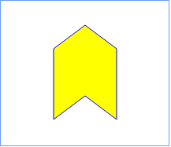
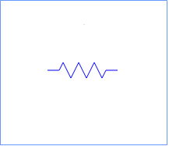
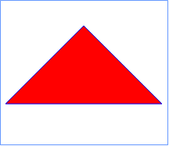
Drawing Straight Lines (2 of 2)
Examples
See StraightLines.html
Rectangles
Polygon
Polyline
Path

Slide 8
2. Drawing Curves
Overview
Drawing circles and ellipses
Drawing arcs
Drawing quadratic curves
Drawing cubic curves

Slide 9
Overview
On this and the following slides, we show how to draw various kinds of curves in SVG
Examples
See Curves.html

Slide 10
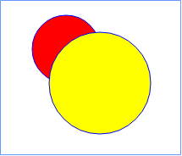
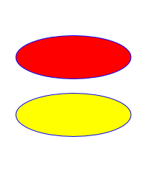
Drawing Circles and Ellipses
To draw circles:
To draw ellipses:
<circle cx="120" cy="80" r="40"
stroke="blue" fill="red" />
<circle cx="160" cy="120" r="60"
stroke="blue" fill="yellow" />
<ellipse cx="150" cy="60" rx="110" ry="30"
stroke="blue" fill="red" />
<ellipse cx="150" cy="140" rx="110" ry="30"
stroke="blue" fill="yellow" />

Slide 11
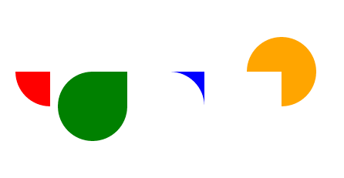
Drawing Arcs
To draw arcs:
Use a <path> element with an "A" flag
A radiusX radiusY xAxisRotation largeArc clockwise endX endY
<path fill="red"
d="M 100 180
A 45 45, 0, 0, 0, 145 225
L 145 180 Z" />
<path fill="green"
d="M 200 180
A 45 45, 0, 1, 0, 245 225
L 245 180 Z" />
<path fill="blue"
d="M 300 180
A 45 45, 0, 0, 1, 345 225
L 345 180 Z" />
<path fill="orange"
d="M 400 180
A 45 45, 0, 1, 1, 445 225
L 445 180 Z" />

Slide 12
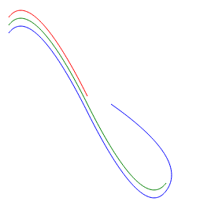
Drawing Quadratic Curves
To draw quadratic curves:
Use a <path> element with a "Q" flag
Also use "T" flags to create follow-on quadratic curves
Q cpX cpY endX endY
T endX endY
<path stroke="red" fill="none"
d="M 20 40
Q 50 0, 120 140" />
<path stroke="green" fill="none"
d="M 20 50
Q 50 10, 120 150
T 220 250" />
<path stroke="blue" fill="none"
d="M 20 60
Q 50 20, 120 160
T 220 260
T 150 150" />

Slide 13
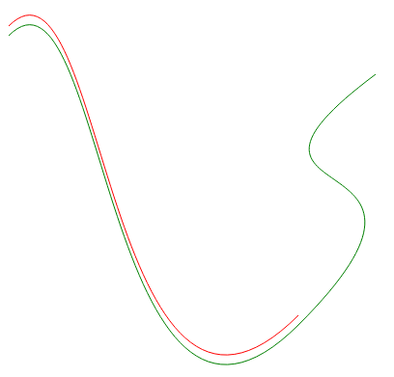
Drawing Cubic Curves
To draw cubic curves:
Use a <path> element with a "C" flag
Also use "S" flags to create follow-on cubic curves
C cp1X cp1Y cp2X cp2Y endX endY
S cp2X cp2Y endX endY
<path stroke="red" fill="none"
d="M 70 100
C 170 0, 170 600, 370 400" />
<path stroke="green" fill="none"
d="M 70 110
C 170 10, 170 610, 370 410
S 250 300, 450 150" />

Slide 14
3. Setting Styles
Basic stroke and fill styles
Setting line styles
Gradients and patterns
Examples

Slide 15
Basic Stroke and Fill Styles
To set a fill style or a stroke style, set these attributes:
stroke="color"
fill="color"
stroke-opacity="opacity-fraction"
fill-opacity="opacity-fraction"
stroke-width="width"
fill-rule="nonzero" | "evenodd"
stroke-dasharray="dash-gap series"
You can also define properties as CSS styles:
style="stroke:color1; fill:color2"

Slide 16
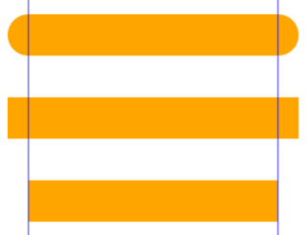

Setting Line Styles
To define line endings:
To define what happens at path joints:
stroke-linecap="round" | "square" | "butt"
stroke-linejoin="bevel" | "round" | "miter"

Slide 17
Gradients and Patterns
To fill a shape with a gradient or a pattern:
<defs>
<linearGradient id="gradient1a" x1="0%" y1="0%" x2="100%" y2="0%"
gradientUnits="objectBoundingBox">
<stop offset="0.2" stop-color="yellow" />
<stop offset="0.5" stop-color="green" />
<stop offset="1.0" stop-color="red" />
</linearGradient>
<radialGradient id="gradient2" fx="0.3" fy="0.3"
gradientUnits="objectBoundingBox">
<stop offset="0.1" stop-color="yellow" />
<stop offset="0.7" stop-color="red" />
</radialGradient>
<pattern id="wales" patternUnits="userSpaceOnUse" width="100" height="100">
<image xlink:href="wales.png" x="0" y="0" width="100" height="100" />
</pattern>
</defs>
<polygon points="50,50 250,50 150,200" fill="url(#gradient1a)" />
<ellipse cx="150" cy="50" rx="100" ry="20" fill="url(#wales)" />
<circle cx="150" cy="250" r="50" fill="url(#gradient2)" />
…

Slide 18
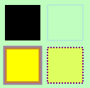
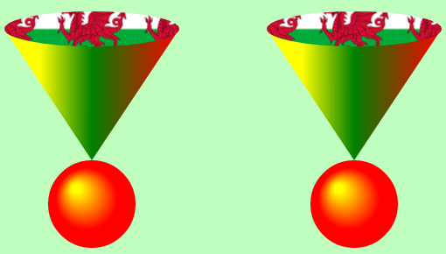
Examples
Examples
See Colours.html
Fill styles and stroke styles
Gradients and patterns

Slide 19
4. Additional Techniques
Drawing text
Transformations
Animations
Interacting with SVG elements
Examples

Slide 20
Drawing Text (1 of 2)
To draw text:
Useful text attributes:
fill, stroke, stroke-width
font-size, font-family, font-weight
text-decoration
Additional text techniques:
Use <linearGradient>, <radialGradient>, and <pattern>
Use <textPath> to draw the text on a path
Use <tspan> to define separately-styled sections in a text path
<text x="20" y="100">
Simple text
</text>

Slide 21


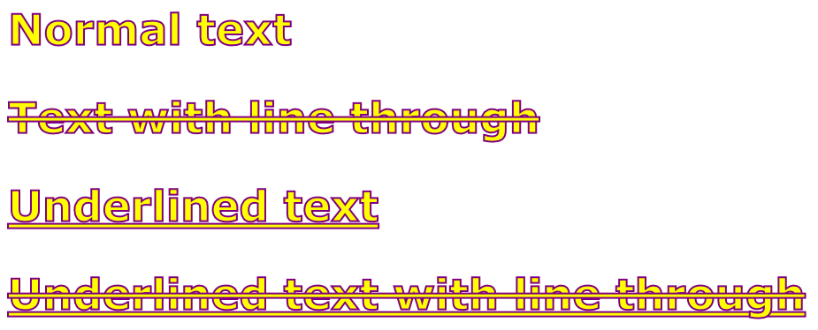
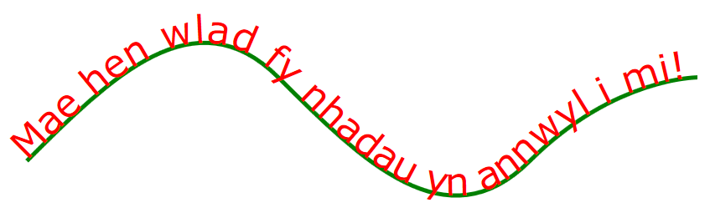
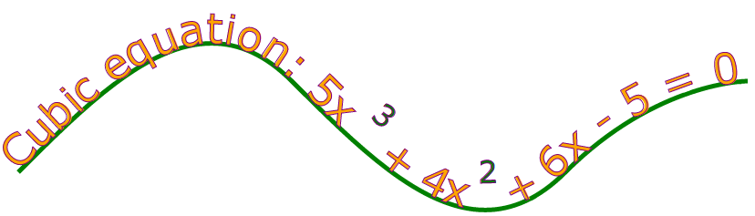
Drawing Text (2 of 2)
Examples
See Text.html

Slide 22
Transformations
To transform SVG elements:
Set the transform attribute to a transformation function
The following transformation functions are available:
To perform the same transformation on several elements:
Enclose the elements in a <g> element, and transform the <g>
rotate(angle, cx, cy)
translate(dx, dy)
scale(sx, sy)
skewX(angle)
skewY(angle)
matrix(m11, m12, m21, m22, dx, dy)

Slide 23
Animations
SVG provides a range of animation elements
<animate>
<animateTransform>
<animateColor>
<animateMotion>
For full details:
See http://www.w3.org/TR/SVG/animate.html

Slide 24
Interacting with SVG Elements
Techniques:
You can apply CSS styles to SVG elements
You can handle events on SVG elements
You can combine events and styles

Slide 25
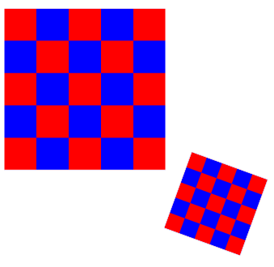
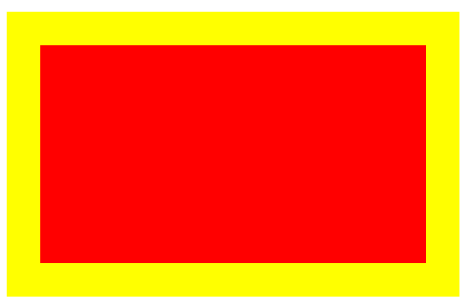
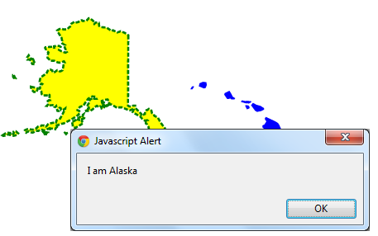
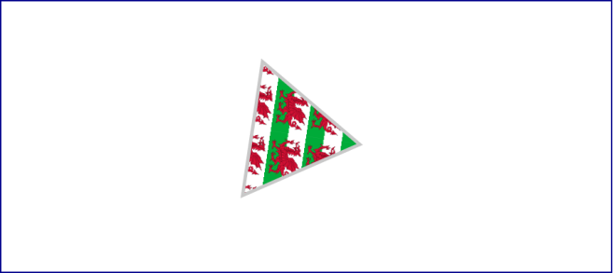
Examples
Examples of transformations, animations, and events:
See TransformationsAnimationsEvents.html
Transformations
Animations
Events

Slide 26
Any Questions?

